Slide 1
4 XPath
XPath is an path expression language for guiding and querying advanced by W3C, and can query or locate the node in the hierarchy XML document
The semi-structured document can be viewed as a DOM tree
  the root of the document is the root of the DOM tree
  The leaf of the document refers to the empty element or text element
  The information in the DOM tree can be described by the nodes and the path between themselves.
The Xpath query aims to the semi-structured document return the satisfied nodes or the sub-tree with the satisfied node as the root
Notes:
XPath 是 W3C 制定的、用来在 XML 文档中进行导航和查询的路径表达语言，可以对 XML 文档层次结构中的相关元素节点及内容进行检索、定位。
半结构化文档可以被看成为一棵树，文档的根节点对应于 DOM 树的根节点，叶节点对应于空的元素节点或者是文本节点，DOM 树蕴含的信息通过树中节点数据及其节点之间的路径关系来进行描述。
针对这种半结构化树所进行的 XPath 查询将返回满足指定特征（包括节点特征和路径特征）的节点或以这样的节点为根的子树。

Slide 2
XPath Standard
In W3C, XPath 2.0 is the new standard, and it is a descriptive language to process the XPATH data model
The data model provides a DOM expression, which contains atom value (like integer, string, Boolean, value) and sequence (a series of atom value)

Slide 3
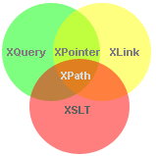
XPath ‘s application
XPath is a basic technology to process XML data
It is used in the key and keyref mechanisms in chapter 3
It is widely used in XQuery, XPointer, XLink

Slide 4
4.1 The data model in XPath
In Unix，Everything is a file
In Java, Everything is an object
In XPath, every value is a sequence
In XPath 2.0 ，the result of every expression is a sequence consist of 0 or more items

Slide 5
4.1.1 Sequence
Sequence is a new concept in W3C Xpath2.0
XPath 1.0 supports only node sets, which is a unordered set with unrepeated nodes
XPath 2.0 supports sequence, which is an ordered set with repeated nodes
(a, b, c) and (c, b, a) are different sequence in Xpath 2.0
The condition for the same sequence includes
  the number of the items is the same
  The item in the same position is the same

Slide 6
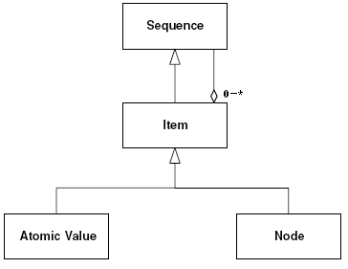
UML class diagram for Sequence
It is a recursive sequence
  A sequence is consist of 0 or more items
  A item itself can be a sequence, or a node, or an atom value,

Slide 7
Sequence：ordered set
Sequence is an ordered set, and each item has its own position
The position of the first item in the sequence is 1, and so on.
We can use count($S) to compute the number of the items in the sequence
We can use $S[i] to access the ith item in the sequence S, which is similar to access the element in an array
We can use position() to decide the position of current item in the sequence

Slide 8
Sequence: computing expression
I． (10, 1, 2, 3, 4) constructs a sequence containing 5 integer
II． ( ) constructs an empty sequence
III．(1, 2, 4, 2) constructs a sequence containing two items with the same value
IV．(1, <a>abc</a>) constructs a sequence with atom value and nodes
V． (10, (1, 2), ( ), (3, 4)) is actual equal to (10, 1, 2, 3, 4)
VI．(10, 1 to 4) is actual equal to (10, 1, 2, 3, 4)
①Sequence construction
②Sequence filter
③Sequence composition
I． (1 to 100)[. mod 5 eq 0] get the items can be divided by 5
II． $orders[fn:position() = (5 to 9)] get the order from 5th to 9th in $orders
union、intersect、except
Given as $seq1 (A, B)、$seq2 (A, B)、$seq3 (B, C)。
I． $seq1 union $seq2 result：(A, B)
II． $seq1 intersect $seq3 result：(B)
III．$seq1 except $seq3 result：(A)

Slide 9
XPath Data Model: Tree
Document node
Element
Attribute Nodes
Text Nodes
Namespace Nodes
PI Nodes
Comment Nodes
Notes:
在 XPath 中，将 XML 文档作为一颗逻辑上的文档树进行处理，以便通过路径对其中的节点进行寻址。这种文档树中一共包含其中类型的节点：文档节点（Document node）、元素节点（Element Nodes）、属性节点（Attribute Nodes）、文本节点（Text Nodes）、命名空间节点（Namespace Nodes）、处理指令节点（PI Nodes）、注释节点（Attribute Nodes）。

Slide 10
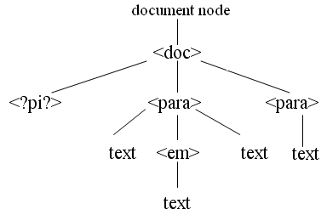
An Example Tree
<doc>
<?Pub Caret?>
<para>Some <em>emphasis</em> here. </para>
<para>Some more stuff.</para>
</doc>

Slide 11
Character——Node Name
Normally, each node in the tree has a name
The name is a simple local name or fully name with the namespace as prefix
We can use function node-name() to get the name of the node
For different nodes, the result is different
  As an element, node-name() return the name of the element
  As an attribute, node-name() return the name of the attribute
  As a PI node, node-name() return the name of the PI
  As a namespace node, node-name() return the name of the namespace
  There is no name for comment or text node return none.
Notes:
对于处理指令节点，该函数将返回处理指令的名称；对于命名空间节点，该函数将返回命名空间的前缀。但是，对于文档节点、注释节点、文本节点，它们是没有名称的，所以 node-name() 函数将一个空序列。
namespace-uri() 可以返回节点的命名空间全称

Slide 12
Character——String Value
Normally, each node in the tree has string value
We can use string( ) to get the result
For text node, the string value is its content
For attribute node, the string value is its content
For element node, the string value is the integrated value for all leaves of the subtree, in which the node is the root
<para>Some <em>emphasis</em> here. </para>
String(/para)=Some emphasis here.
Notes:
对于文本节点，其字符串值就是该文本节点的内容；对于属性节点，其字符串值就是该属性的取值。对于元素节点，其字符串值是将以该节点为根的子树的所有文本叶节点从左到右串联起来的结果：

Slide 13
Character——Node identity
Each node in the tree has an unique identify different from each other.
We can use “is” to compare two nodes whether they are the same
  same structure
  same content.
Notes:
对于 XML 文档树中的每个节点，系统将采用特定的方式对其进行标识，以便将一个节点与另一个节点区分开来，通常可以使用 is 操作符比较两个节点是否为同一个节点，而通过等值的比较是无法实现这一点的，因为它只能够判断两个节点的内容、结构是否相等。

Slide 14
4.2 XPath grammar
4.2.1 XPath simple example
<library> <book> <chapter> </chapter> <chapter> <section> <paragraph/> <paragraph/> </section> </chapter> </book> </library> | library is the parent of book ； book is the parent of the two chapter。 The two chapter elements are book’s child，and section is the child of the second chapter The two chapter elements are the children of book, and are sibling library、book and the second chapter is the ancestor of the section The two chapter 、section、and the two paragraph，are the desendant elements of the element book Relationship：parent、child、sibling、ancestor、desendant

Slide 15
4.2.2 XPath full grammar expression
LocationPath ::= RelativeLocationPath | AbsoluteLocationPath (1)
RelativeLocationPath ::= Step | RelativeLocationPath '/' Step | AbbrevRelativeLocationPath (2)
AbsoluteLocationPath ::= '/'RelativeLocationPath? | AbbrevAbsoluteLocationPath (3)
The location path expression can be relative Location expression or absolute location expression
The absolute location expression begins with /，the following is the relative Location expression or the abbreviated absolute location expression
The relative location expression is consisted of more Step, like Step1/Step2/Step3

Slide 16
XPath full grammar expression
Step::=AxisSpecifier NodeTest Predicate* (4)
AxisSpecifier::=AxisName '::'| AbbreviatedAxisSpecifier (5)
AxisName::='ancestor'| 'ancestor-or-self'| 'attribute'| 'child'| 'descendant' | 'descendant-or-self'
| 'following'| 'following-sibling'| 'namespace' | 'parent'| 'preceding'| 'preceding-sibling'| 'self' (6)
NodeTest ::= NameTest | KindTest (7)
每个 Step 由三个部分组成，轴标识符（AxisSpecifier）＋节点测试（NodeTest）＋零个或多个判定谓词（Predicate*）。其中，轴标识符表示对于当前节点（因为是相对位置路径表达式）往“哪个方向”进行查找，节点测试则通过给出节点的名称指出要查找“哪些节点（名称或者类型如何）”，而判定谓词表示对所查找到的节点按照指定的方式“进行筛选”。
表示在 XML 文档树中，查找从文档节点到当前节点所经过的路径上的所有节点，不包括当前节点。
表示 ancestor 关系轴查找的结果，再加上当前节点。
表示查找当前节点的子节点。
表示以当前节点为根的子树中的所有节点，不包括当前节点。
表示查找当前节点的属性。
表示 descendant 关系轴查找的结果，再加上当前节点。
表示在 XML 文档树中，查找从文档节点到当前节点所经过的路径上的所有节点，不包括当前节点。
To serch the current node’s sttrug表示查找当前节点的属性。
表示查找在当前节点之后的节点，换句话说，这些节点开始标记和结束标记都在当前节点的结束标记之后。
表示查找当前节点的命名空间。
表示查找当前节点的父节点。
表示查找在当前节点之后的兄弟节点。
表示查找在当前节点之前的节点，换句话说，这些节点开始标记和结束标记都在当前节点的开始标记之前。
表示查找在当前节点之前的兄弟节点。
表示查找当前节点本身。
There is 13 relationship axis, each expresses a direction from the current node

Slide 17
example
<library>
<book>
<chapter/>
<chapter>
<section>
<paragraph/>
<paragraph/>
</section>
</chapter>
<chapter/>
</book>
<book/>
</library>
//chapter[2]/self::*
//chapter[2]/preceding::*
//chapter[2]/following::*
//chapter[2]/ancestor::*
//chapter[2]/descendant::*

Slide 18
Short name of Axim
/library/book is equal to /child::library/child::book
We can use some short name to write Xpath expression
Short name | Is equal to fully expression
 | child::
@ | attribute::
. | self::node()
.//X | self::node()/descendant-or-self::node() /child::X
.. | parent::node()
../X | parent::node()/child::X
// | /descendant-or-self::node()/
//X | /descendant-or-self::node()/child::X

Slide 19
Node test
NodeTest ::= NameTest | KindTest
The node test can be name test or type test
Name test means to test/filter the name of the current nodes
Type test means to test/filter the type of the current nodes (suit for element or attribute nodes, not suit for text or comment node)

Slide 20
Node test example
/library/descendant::book is used to search /library to find the descendant nodes
With the name book
/library/child::node() is used to search the all the children nodes of node library
/library/book/text() is used to search all the text children node of the node book
We can use wildcard character “*” in the node test to match any element node

Slide 21
Charging predicate
Use Square brackets for further
/library/book[1] means the first book element, which is equal to expression /library/book[position() = 1]；
/library/book[@name = “TCP/IP”] means the book node
with the attribute named "TCP/IP"
/library/book/chapter[last()-1] means to search the last second
chapter node

Slide 22
XPath examples and tests
I． //book/descendant::* 表示所有 book 元素节点的所有子孙元素节点；
II． /library/book/chapter/* 表示 library 的所有 book 元素节点的所有 chapter 元素节点的所有子元素节点；
III．//chapter[@num='3'] 表示所有的 num 属性等于 3 的 chapter 元素节点；
IV．/*/*/*/paragraph 表示在 XML 文档树第 4 层中所有的 paragraph 元素节点；
V．/library/book[3]/following::* 表示 library 的第 3 个 book 元素节点之后的所有节点；
VI．//chapter[not(@*)] 表示所有不包含任何属性的 chapter 元素节点。
VII．//parent::* 表示选择出所有的分支节点（非叶节点）。请读者思考一下，如果反过来，要求查询所有的叶节点，XPath 又应该怎样编写呢？
VIII．//chapter[count(section)=2] 表示选择出所有包含两个 section 的 chapter 元素。
Notes:
I． //book/descendant::* 表示所有 book 元素节点的所有子孙元素节点；
II． /library/book/chapter/* 表示 library 的所有 book 元素节点的所有 chapter 元素节点的所有子元素节点；
III．//chapter[@num='3'] 表示所有的 num 属性等于 3 的 chapter 元素节点；
IV．/*/*/*/paragraph 表示在 XML 文档树第 4 层中所有的 paragraph 元素节点；
V．/library/book[3]/following::* 表示 library 的第 3 个 book 元素节点之后的所有节点；
VI．//chapter[not(@*)] 表示所有不包含任何属性的 chapter 元素节点。
VII．//parent::* 表示选择出所有的分支节点（非叶节点）。请读者思考一下，如果反过来，要求查询所有的叶节点，XPath 又应该怎样编写呢？
VIII．//chapter[count(section)=2] 表示选择出所有包含两个 section 的 chapter 元素。

Slide 23
Question 1
<bib>
<book year="1994">
<title>TCP/IP Illustrated</title>
<author>
<last>Stevens</last>
<first>W.</first>
</author>
</book>
<book year="2000">
<title>Data on the Web</title>
<author>
<last>Abiteboul</last>
<first>Serge</first>
</author>
<author>
<last>Buneman</last>
<first>Peter</first>
</author>
</book>
</bib>
/bib/book/author[1] ？？
node 1： <author> <last>Stevens</last> <first>W.</first> </author> |  | node 2： <author> <last>Abiteboul</last> <first>Serge</first> </author>

Slide 24
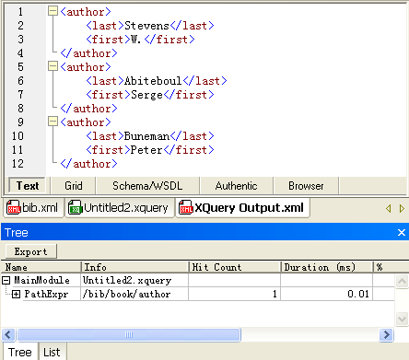
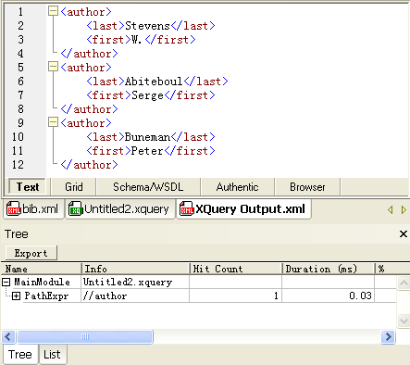
Question 2: speed
<author>
<last>Stevens</last>
<first>W.</first>
</author>
<author>
<last>Abiteboul</last>
<first>Serge</first>
</author>
<author>
<last>Buneman</last>
<first>Peter</first>
</author>
I. /bib/book/author
II. //author
/descendant-or-self::node()/author

Slide 25
4.4 XPath ‘s function
XPath 2.0 provides many build-in functions to operate the nodes, or the sequence
The functions are used in XPath expression, and used in XSLT, XQuery too
The fully list are shown in
www.w3.org/TR/xpath-functions/

Slide 26
4.4.1 XPath ‘s operational character
kind | detail | list
arithmetic | Single operation number | "-"、"+"
 | Double operation number | "+"、"-"、"*"、"div"、"idiv"、"mod"
compare | Compare value | "eq"、"ne"、"lt"、"le"、"gt"、"ge"
 | General compare | "="、"!="、"<"、"<="、">"、">="
 | Compare node | "is"、"<<"、">>"
logical |  | "or"、"and"
值比较运算符用于对两个单值进行比较。
例如，$book1/author eq “Kennedy” 将比较 book1 中唯一的 author 元素的内容是否为 “Kennedy“。
但是如果 book1 中存在多个 author 元素，则应该使用通用比较运算符，而不是值比较运算符，否则会产生一个类型错误；
单目、双目算术运算符的区别仅在于参加运算的操作数的个数；
通用比较运算符假设参加比较运算的是两个序列，其判断过程中采用的是存在语义（Exist Semantic），即只要两个序列中存在一对满足该比较运算符的值，就认为结果为“真”，否则为“假”。
I．(1, 2) = (2, 3) true
II．(2, 3) = (3, 4) true
III．(2, 3) != (3, 4) true
IV．(1, 2) = (3, 4) false
节点比较运算符用于比较两个节点，其中 "is" 用于比较两个节点的标识（Identity）是否相同，而不是节点的内容。"<<" 和 ">>" 则用于比较两个节点的文档序（Document Order）的次序。文档序是指节点在文档中的位置顺序。
逻辑运算符的使用与高级程序设计语言中逻辑运算符的使用相同，用于连接多个布尔表达式。

Slide 27
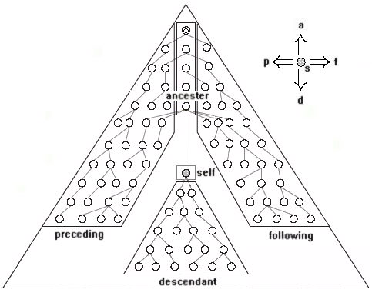
Document Order
The identity means the position, which can be used to distinguish two nodes
$V_{preceding}∪$V_{ancestor}=$V<<
$V_{following}∪$V_{descendant}=$V>>
$V means the node set of the axix
<couple><husband>Tom</husband><wife>Alice</wife></couple>
I． /couple/husband is //husband true
II． <a>5</a> is <a>5</a> false
<couple><husband>Tom</husband><wife>Alice</wife></couple>
III． /couple/husband << /couple/wife true
IV．/couple << /couple/wife true
V． /couple/wife >> /couple/wife/text( ) true
VI．/couple/husband >> /couple/wife/text( ) false
Notes:
节点的标识（Identity）指
的是节点在文档中的位置，用以区分不同的节点，如果两个节点的标识相同，那么这两个节点是同一个节点。

Slide 28
Xpath’s build-in function
4.4.2 get /set function
4.4.3 math computing
4.4.4 string
4.4.7 date, time
4.4.8 QNames
4.4.9 node
4.4.10sequence
4.4.11set

